Slide 1
Manifold Learning and Artificial Intelligence
Lecture 5
Generative AI (3)
Optimal Denoising Diffusion Models
Momiao Xiong, University of Texas School of Public Health
Time: 9:00 pm, US East Time, 12/03/2022
10:00 am, Beijing Time. 12/04/2022
Zoom https://uwmadison.zoom.us/j/93316139423?pwd=Q0NVWFYvRFg5RmxCNkwxMmYrbW41dz09
Meeting ID: 933 1613 9423
Passcode: 416262
Github Address: https://ai2healthcare.github.io/

Slide 2
Future Topics Generative AI will cover
Variational Diffusion Models
Stochastic Differential Equation-based Generative Models
Diffusion Models for Protein Design
Equivariant Diffusion for Molecule Generation in 3D
Conditional Diffusion Model for Time Series
Regression Diffusion Models
Spatial-Temporal Diffusion
Self-Supervised Learning based on Heat Equation
Poisson Flow Generative Models
Diffusion Model for Causal Inference

Slide 3
Ho, J., Jain, A., and Abbeel, P. (2020) Denoising diffusion probabilistic models.
Day, 2021, An introduction to Diffusion Probabilistic Models
Fan et al. 2022, Estimating the Optimal Covariance with Imperfect Mean in Diffusion Probabilistic Models
Bao, et al. 2022; ANALYTIC-DPM: AN ANALYTIC ESTIMATE OF THE OPTIMAL REVERSE VARIANCE IN DIFFUSION PROBABILISTIC MODELS

Slide 4
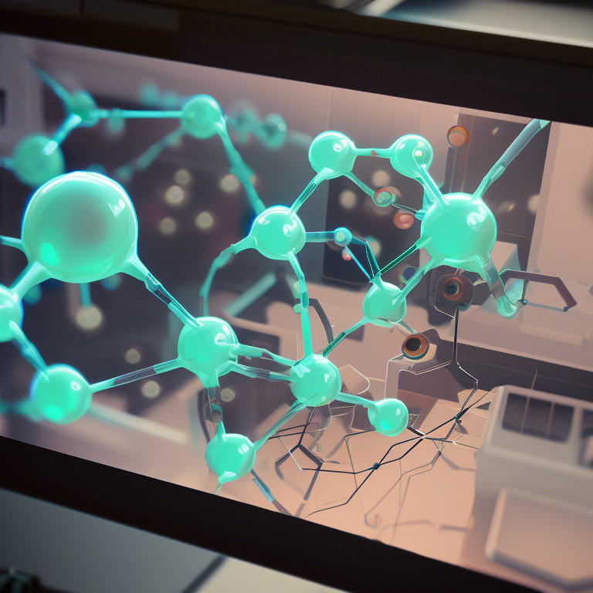
Michael Galkin, 2022. Denoising Diffusion Generative Models in Graph ML

Slide 5
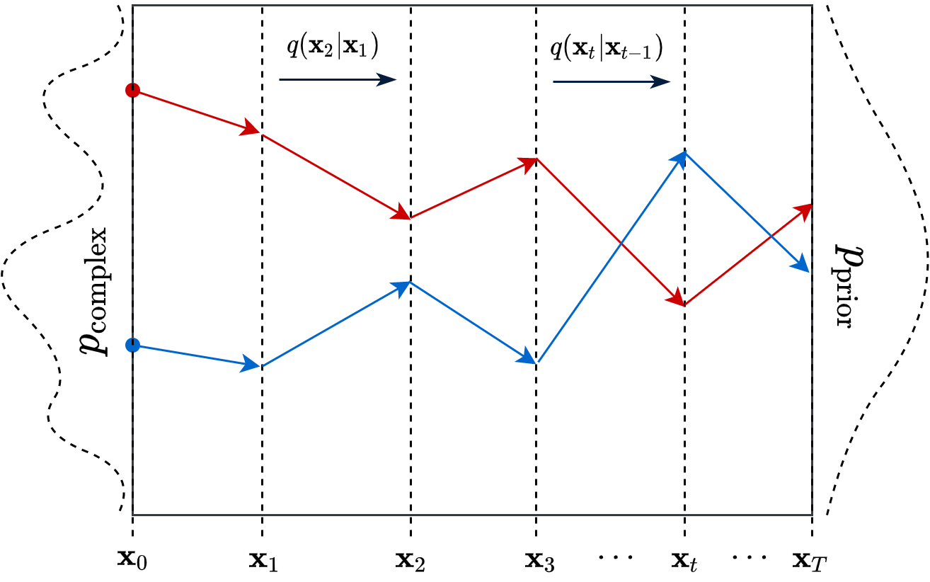
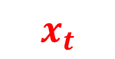
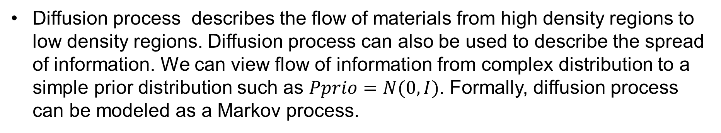
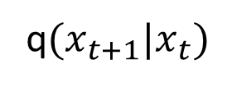
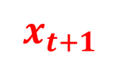
1.5. Denoise Diffusion Probability Model
Diffusion process describes the flow of materials from high density regions to low density regions. Diffusion process can also be used to describe the spread of information. We can view flow of information from complex distribution to a simple prior distribution such as $Pprio=N(0,I)$. Formally, diffusion process can be modeled as a Markov process.
$$x_{t}$$
$$x_{t+1}$$
q$(x_{t+1}|x_{t})$
Day, 2021, An introduction to Diffusion Probabilistic Models
https://ayandas.me/blog-tut/2021/12/04/diffusion-prob-models.html

Slide 6
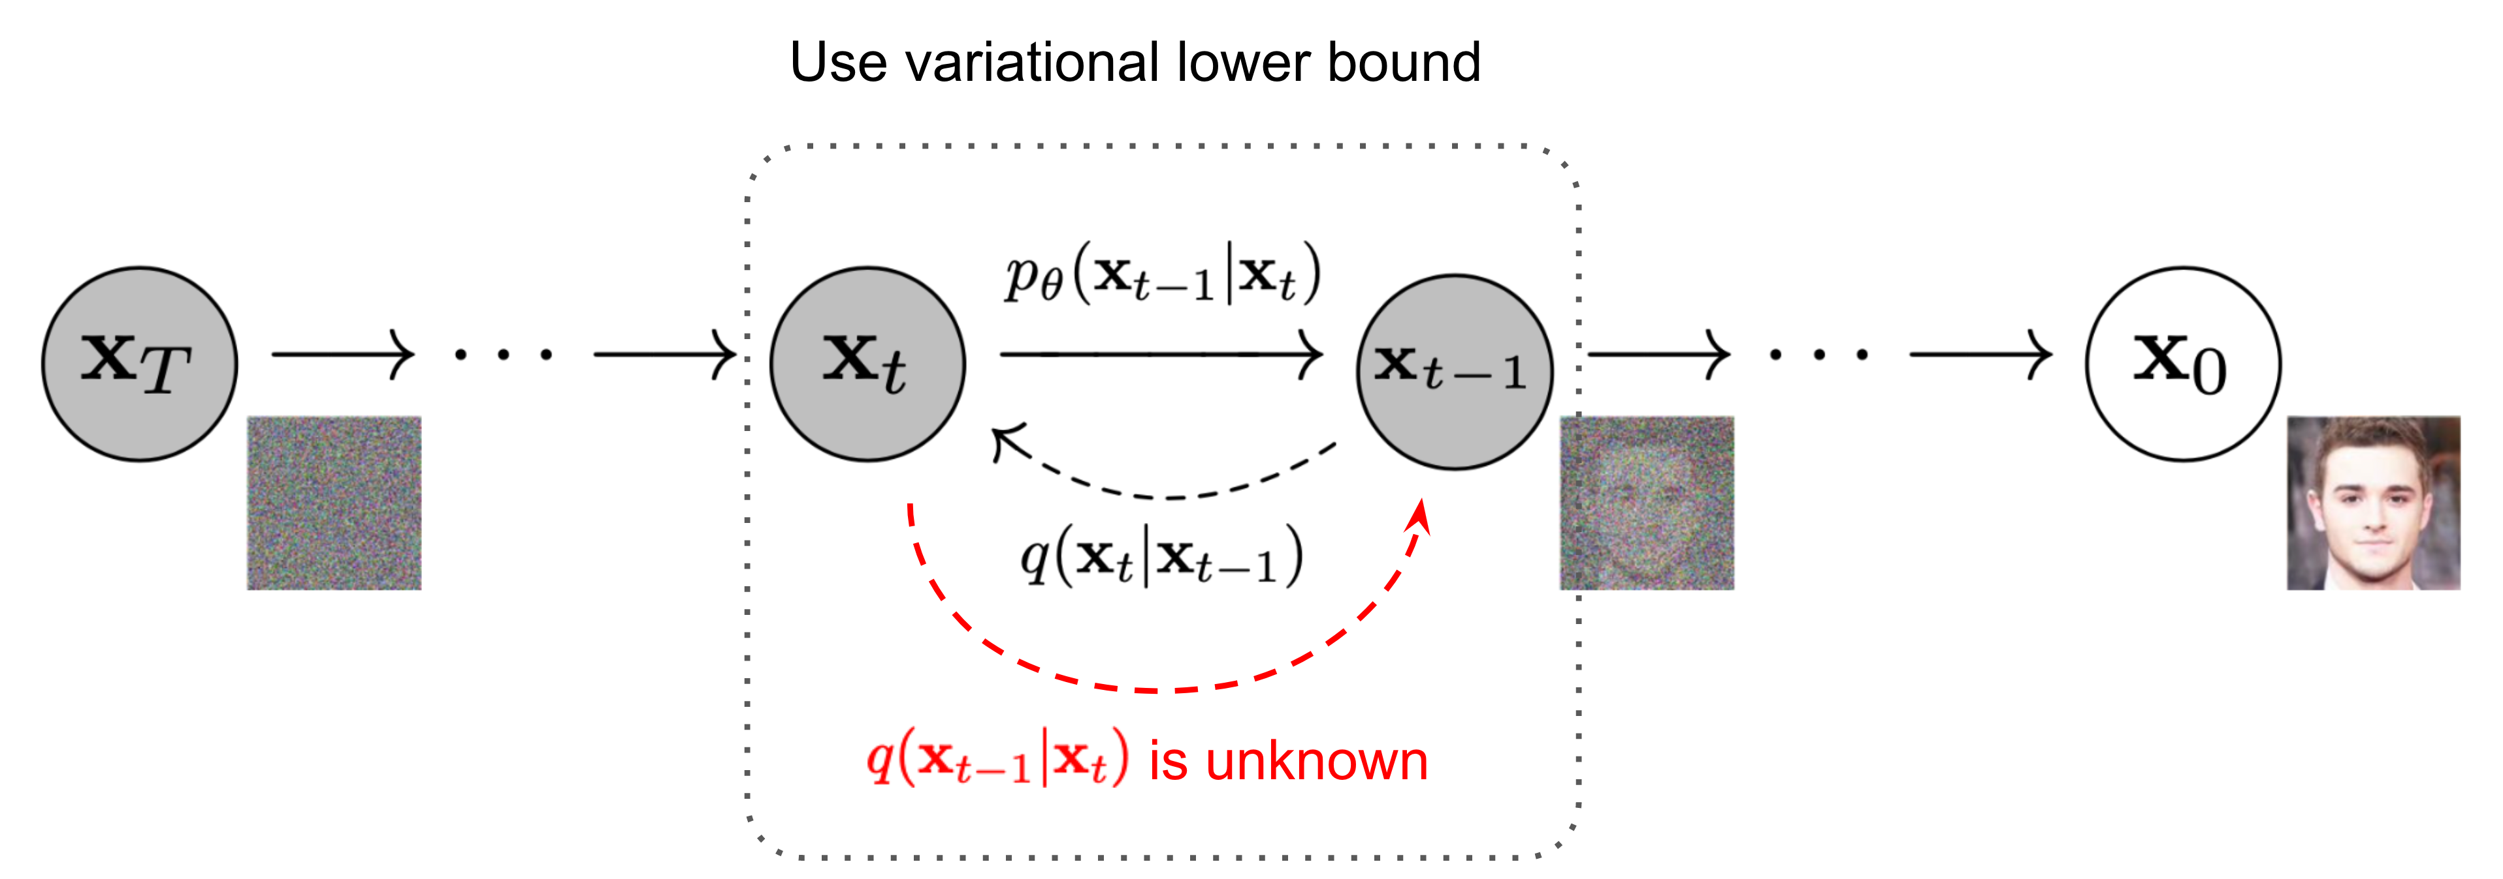
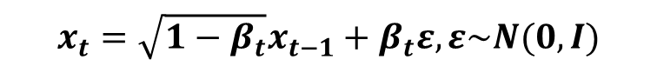
1.5.1. Forward Diffusion Process
Probability Model
$x_{0}\sim P_{data}\left(x\right)→x_{1}→x_{2}→…→x_{N}$, a Markov Process in which
small amount of Gaussian noise to the sample in $T$ steps are added.
The step sizes are controlled by a variance schedule $β_{1},…, β_{T}, β_{t}∈(0,1)$.
$$q\left(x_{t} | x_{t−1}\right)=N\left(x_{t}; \sqrt{1−β_{t}}x_{t−1}, β_{t}I\right), q\left(x_{T}\right)=P_{prior}\left(X_{T}\right)=N(X_{T},;0, I)$$
$$x_{t}=\sqrt{1−β_{t}}x_{t−1}+β_{t}ε, ε\sim N(0,I)$$
LiLiang, Weng 2021, What are Diffusion Models?
https://lilianweng.github.io/posts/2021-07-11-diffusion-models/#forward-diffusion-process

Slide 7
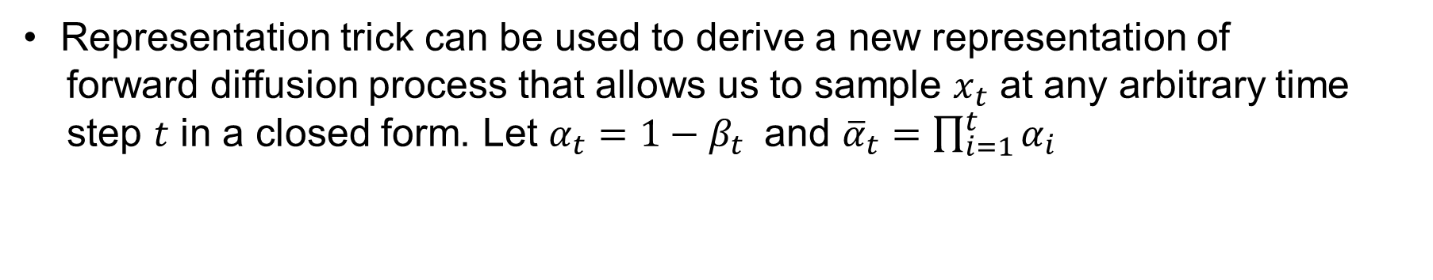
$$q\left(x_{1:T|x_{0}}\right)=q\left(x_{1} | x_{0}\right)q\left(x_{2} | x_{1}\right)…q\left(x_{T} | x_{T−1}\right)=\prod_{t=1}^{T}{q(x_{t}|x_{t−1})}$$
1.5.2. Reparameterization Trick
Representation trick can be used to derive a new representation of
forward diffusion process that allows us to sample $x_{t}$ at any arbitrary time
step $t$ in a closed form. Let $α_{t}=1−β_{t}$ and ${\overline{α}}_{t}=\prod_{i=1}^{t}{α_{i}}$
Note that
$$x_{t}=\sqrt{α_{t}}x_{t−1}+\sqrt{1−α_{t}}ε_{t−1}, ε_{t−1}\sim N(0,I)$$
$$=\sqrt{α_{t}}\left(\sqrt{α_{t−1}}x_{t−2}+\sqrt{1−α_{t−1}}ε_{t−2}\right)+\sqrt{1−α_{t}}ε_{t−1}, ε_{t−2}\sim N(0,I)$$
$$=\sqrt{α_{t}α_{t−1}}x_{t−2}+\sqrt{α_{t}(1−α_{t−1})}ε_{t−2}+\sqrt{1−α_{t}}ε_{t−1.}$$
However, let ${\overline{ε}}_{t−2}=\sqrt{α_{t}(1−α_{t−1})}ε_{t−2}+\sqrt{1−α_{t}}ε_{t−1.}$ Then,
$E\left[{\overline{ε}}_{t−2}\right]=0, Var\left({\overline{ε}}_{t−2}\right)=$ $α_{t}\left(1−α_{t−1}\right)+1−α_{t}=1−α_{t}α_{t−1}$
${\overline{ε}}_{t−2}\sim N(0, (1−α_{t}α_{t−1}$)I)

Slide 8
Recursively, we can write
$$x_{t}=\sqrt{α_{t}α_{t−1}}x_{t−2}+\sqrt{1−α_{t}α_{t−1}}{\overline{ε}}_{t−2}$$
$$=\sqrt{α_{t}α_{t−1}α_{t−2}}x_{t−3}+\sqrt{1−α_{t}α_{t−1}α_{t−2}}{\overline{ε}}_{t−3}$$
$$⋮$$
$$=\sqrt{α_{t}α_{t−1}α_{t−2}…α_{1}}x_{0}+\sqrt{1−α_{t}α_{t−1}α_{t−2}…α_{1}}{\overline{ε}}_{0}$$
$$=\sqrt{{\overline{α}}_{t}}x_{0}+\sqrt{1−{\overline{α}}_{t}}ε$$
Therefore, we obtain the transition probability
$q\left(x_{t} | x_{0}\right)=N(x_{t};$ $\sqrt{{\overline{α}}_{t}}x_{0}, \left(1−{\overline{α}}_{t}\right)I),β_{t}↑, {\overline{ α}}_{t}↓$

Slide 9
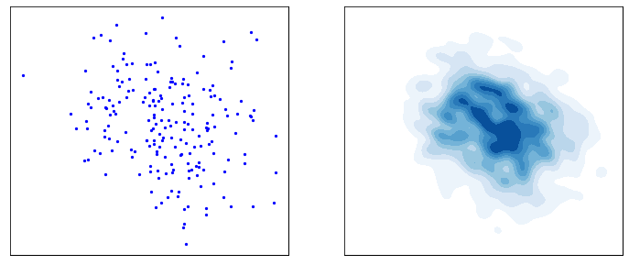
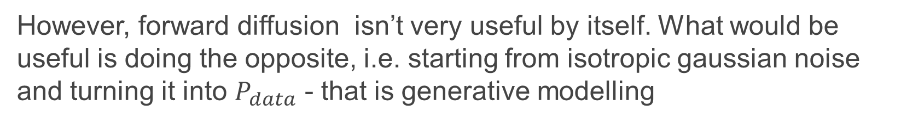
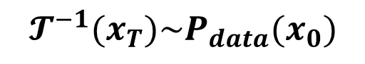
1.5.3. Reverse Diffusion
However, forward diffusion isn’t very useful by itself. What would be useful is doing the opposite, i.e. starting from isotropic gaussian noise and turning it into $P_{data}$ - that is generative modelling
$X_{T}\sim N(0,I)$
$$𝓣^{−1}(x_{T})\sim P_{data}(x_{0})$$
Day, 2021, An introduction to Diffusion Probabilistic Models

Slide 10
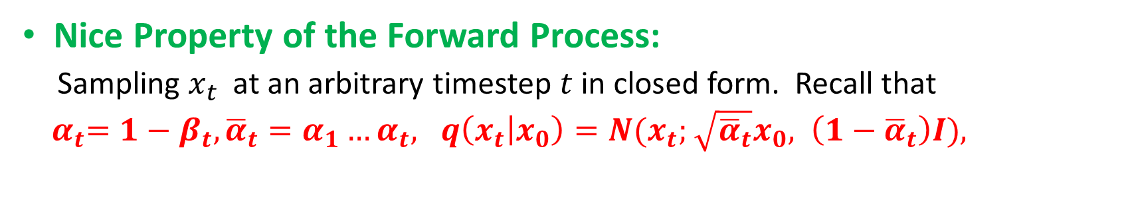
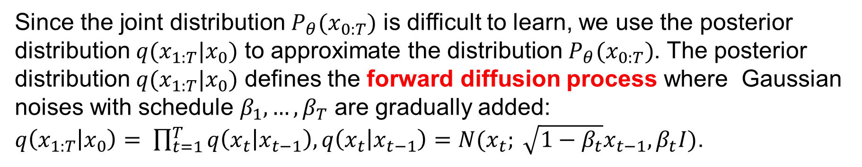
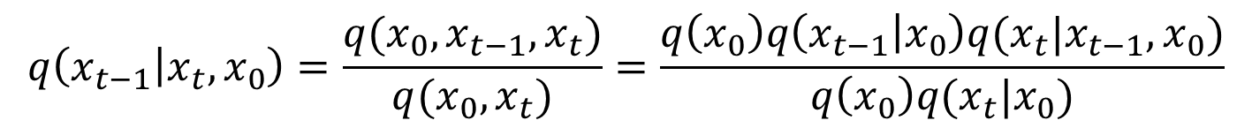
Since the joint distribution $P_{θ}(x_{0:T})$ is difficult to learn, we use the posterior distribution $q(x_{1:T}|x_{0})$ to approximate the distribution $P_{θ}(x_{0:T})$. The posterior distribution $q(x_{1:T}|x_{0})$ defines the forward diffusion process where Gaussian noises with schedule $β_{1},…, β_{T}$ are gradually added:
$q\left(x_{1:T} | x_{0}\right)= \prod_{t=1}^{T}{q\left(x_{t} | x_{t−1}\right),q\left(x_{t} | x_{t−1}\right)=N(x_{t}; \sqrt{1−β_{t}}x_{t−1}, β_{t}I)}$.
Nice Property of the Forward Process:
Sampling $x_{t}$ at an arbitrary timestep $t$ in closed form. Recall that
${ α}_{t}=1−β_{t}, {\overline{α}}_{t}=α_{1}…α_{t}, q\left(x_{t} | x_{0}\right)=N(x_{t};$ $\sqrt{{\overline{α}}_{t}}x_{0}, \left(1−{\overline{α}}_{t}\right)I),$
(1)
To make the reverse transition probability tractable, we conditional the transition probability on $x_{0}$:
$$q\left(x_{t−1} | x_{t},x_{0}\right)=\frac{q(x_{0}, x_{t−1}, x_{t})}{q(x_{0},x_{t})}=\frac{q\left(x_{0}\right)q\left(x_{t−1} | x_{0}\right)q(x_{t}|x_{t−1},x_{0})}{q\left(x_{0}\right)q(x_{t}|x_{0})}$$
$$=\frac{q\left(x_{t−1} | x_{0}\right)q(x_{t}|x_{t−1})}{q(x_{t}|x_{0})}$$
(L)

Slide 11
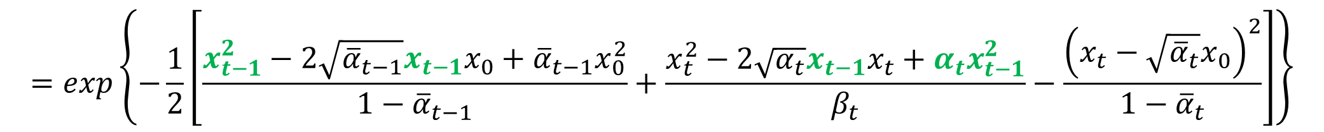

$∝exp\left\{−\frac{1}{2}\left[\frac{{\left(x_{t−1}−\sqrt{{\overline{α}}_{t−1}}x_{0}\right)}^{2}}{1−{\overline{α}}_{t−1}}+\frac{{\left(x_{t}−\sqrt{α_{t}}x_{t−1}\right)}^{2}}{β_{t}}−\frac{{\left(x_{t}−\sqrt{{\overline{α}}_{t}}x_{0}\right)}^{2}}{1−{\overline{α}}_{t}}\right]\right\}$,
Using (1) and (L)
$$=exp\left\{−\frac{1}{2}\left[\frac{x_{t−1}^{2}−2\sqrt{{\overline{α}}_{t−1}}x_{t−1}x_{0}+{\overline{α}}_{t−1}x_{0}^{2}}{1−{\overline{α}}_{t−1}}+\frac{x_{t}^{2}−2\sqrt{α_{t}}x_{t−1}x_{t}+α_{t}x_{t−1}^{2}}{β_{t}}−\frac{{\left(x_{t}−\sqrt{{\overline{α}}_{t}}x_{0}\right)}^{2}}{1−{\overline{α}}_{t}}\right]\right\}$$
$$=exp\left\{−\frac{1}{2}\left[\left(\frac{α_{t}}{β_{t}}+\frac{1}{1−{\overline{α}}_{t−1}}\right)x_{t−1}^{2}−\left(\frac{2\sqrt{α_{t}}}{β_{t}}x_{t}+\frac{2\sqrt{{\overline{α}}_{t−1}}}{1−{\overline{α}}_{t−1}}x_{0}\right)x_{t−1}+C(x_{t}, x_{0})\right]\right\}$$
(2)
From the normal distribution function, we define
$$q\left(x_{t−1} | x_{t}, x_{0}\right)$$
$=N(x_{t−1}|{\tilde{μ}}_{t}\left(x_{t}, x_{0}\right),{\tilde{β}}_{t}I)$
$q\left(x_{t−1} | x_{t}, x_{0}\right)=N(x_{t−1}|$ ${\tilde{μ}}_{t}\left(x_{t}, x_{0}\right), λ_{t}^{2}I)∝−\frac{1}{2}\left[\frac{x_{t−1}^{2}}{λ_{t}^{2}}−2\frac{{\tilde{μ}}_{t}{(x_{t}, x_{0})x}_{t−1}}{λ_{t}^{2}}+\frac{{\tilde{μ}}_{t}^{2}}{λ_{t}^{2}}\right]$
$\frac{1}{{\tilde{β}}_{t}}=\frac{α_{t}}{β_{t}}+\frac{1}{1−{\overline{α}}_{t−1}}=\frac{α_{t}−α_{t}{\overline{α}}_{t−1}+β_{t}}{β_{t}(1−{\overline{α}}_{t−1})}=\frac{α_{t}−{\overline{α}}_{t}+1−α_{t}}{β_{t}(1−{\overline{α}}_{t−1})}=\frac{1−{\overline{α}}_{t}}{β_{t}(1−{\overline{α}}_{t−1})}$, which implies
$${\tilde{β}}_{t}=\frac{1−{\overline{α}}_{t−1}}{1−{\overline{α}}_{t}}β_{t}=\frac{{\overline{β}}_{t−1}}{{\overline{β}}_{t}}β_{t}=λ_{t}^{2}$$
(3)

Slide 12
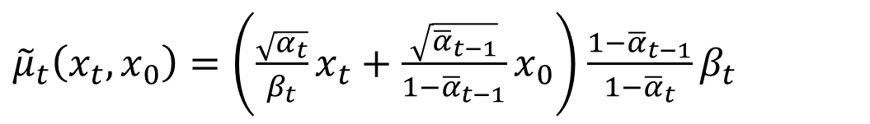
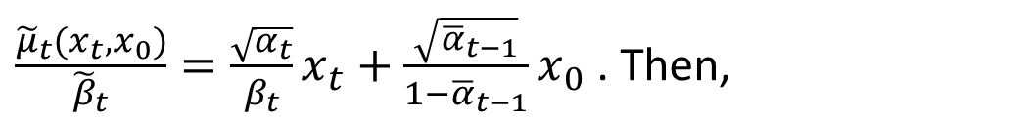
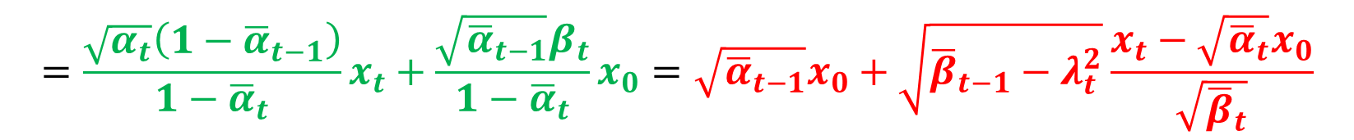
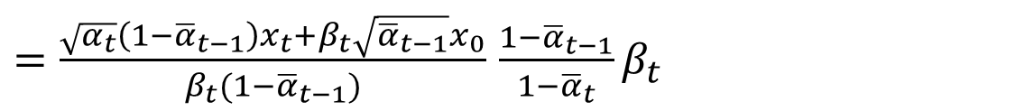
$\frac{{\tilde{μ}}_{t}(x_{t}, x_{0})}{{\tilde{β}}_{t}}=\frac{\sqrt{α_{t}}}{β_{t}}x_{t}+\frac{\sqrt{{\overline{α}}_{t−1}}}{1−{\overline{α}}_{t−1}}x_{0}$ . Then,
Let
${\tilde{μ}}_{t}\left(x_{t}, x_{0}\right)=\left(\frac{\sqrt{α_{t}}}{β_{t}}x_{t}+\frac{\sqrt{{\overline{α}}_{t−1}}}{1−{\overline{α}}_{t−1}}x_{0}\right)$ $\frac{1−{\overline{α}}_{t−1}}{1−{\overline{α}}_{t}}β_{t}$
$=\frac{\sqrt{α_{t}}\left(1−{\overline{α}}_{t−1}\right)x_{t}+β_{t}\sqrt{{\overline{α}}_{t−1}}x_{0}}{β_{t}(1−{\overline{α}}_{t−1})}$ $\frac{1−{\overline{α}}_{t−1}}{1−{\overline{α}}_{t}}β_{t}$
Parameters in Forward Diffusion Process
$$=\frac{\sqrt{α_{t}}\left(1−{\overline{α}}_{t−1}\right)}{1−{\overline{α}}_{t}}x_{t}+\frac{\sqrt{{\overline{α}}_{t−1}}β_{t}}{1−{\overline{α}}_{t}}x_{0}=\sqrt{{\overline{α}}_{t−1}}x_{0}+\sqrt{{\overline{β}}_{t−1}−λ_{t}^{2}}\frac{x_{t}−\sqrt{{\overline{α}}_{t}}x_{0}}{\sqrt{{\overline{β}}_{t}}}$$
(4)
Combining equations (3) and (4), we obtain
$q\left(x_{t−1} | x_{t}, x_{0}\right)=N(x_{t−1}|$ ${\tilde{μ}}_{t}\left(x_{t}, x_{0}\right), λ_{t}^{2}I)=N(x_{t−1}| {\tilde{μ}}_{t}\left(x_{t}, x_{0}\right),{\tilde{β}}_{t}I)$
Bo et al. 2022.ANALYTIC-DPM: AN ANALYTIC ESTIMATE OF THE OPTIMAL REVERSE VARIANCE
IN DIFFUSION PROBABILISTIC MODELS

Slide 13



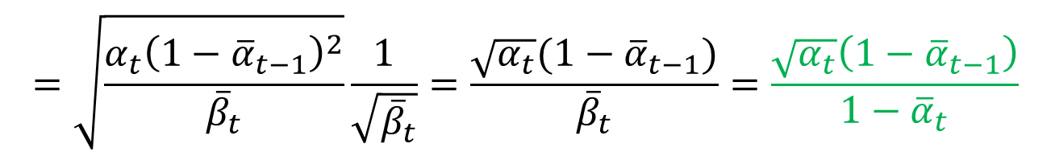

To prove $\frac{\sqrt{α_{t}}\left(1−{\overline{α}}_{t−1}\right)}{1−{\overline{α}}_{t}}x_{t}+\frac{\sqrt{{\overline{α}}_{t−1}}β_{t}}{1−{\overline{α}}_{t}}x_{0}=\sqrt{{\overline{α}}_{t−1}}x_{0}+\sqrt{{\overline{β}}_{t−1}−λ_{t}^{2}}\frac{x_{t}−\sqrt{{\overline{α}}_{t}}x_{0}}{\sqrt{{\overline{β}}_{t}}}$
we first show that
$$\frac{\sqrt{α_{t}}\left(1−{\overline{α}}_{t−1}\right)}{1−{\overline{α}}_{t}}=\sqrt{\frac{{\overline{β}}_{t−1}−λ_{t}^{2}}{{\overline{β}}_{t}}.}$$
$$\frac{{\overline{β}}_{t−1}}{{\overline{β}}_{t}}β_{t}=λ_{t}^{2}$$
Using equation (3) yields
$$\sqrt{\frac{{\overline{β}}_{t−1}−λ_{t}^{2}}{{\overline{β}}_{t}}.}=\sqrt{{\overline{β}}_{t−1}−\frac{{\overline{β}}_{t−1}}{{\overline{β}}_{t}}β_{t}}\frac{1}{\sqrt{{\overline{β}}_{t}}}=\sqrt{{\overline{β}}_{t−1}\frac{\left({\overline{β}}_{t}−β_{t}\right)}{{\overline{β}}_{t}}}\frac{1}{\sqrt{{\overline{β}}_{t}}}$$
$$=\sqrt{\frac{{\overline{β}}_{t−1}\left(α_{t}−{\overline{α}}_{t}\right)}{{\overline{β}}_{t}}}\frac{1}{\sqrt{{\overline{β}}_{t}}}=\sqrt{\frac{{\overline{β}}_{t−1}α_{t}(1−{\overline{α}}_{t−1})}{{\overline{β}}_{t}}}\frac{1}{\sqrt{{\overline{β}}_{t}}}$$
$$=\sqrt{\frac{α_{t}{\left(1−{\overline{α}}_{t−1}\right)}^{2}}{{\overline{β}}_{t}}}\frac{1}{\sqrt{{\overline{β}}_{t}}}=\frac{\sqrt{α_{t}}(1−{\overline{α}}_{t−1})}{{\overline{β}}_{t}}=\frac{\sqrt{α_{t}}\left(1−{\overline{α}}_{t−1}\right)}{1−{\overline{α}}_{t}}$$
(5)

Slide 14
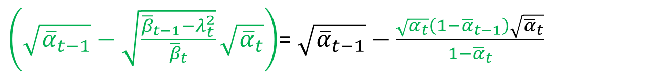

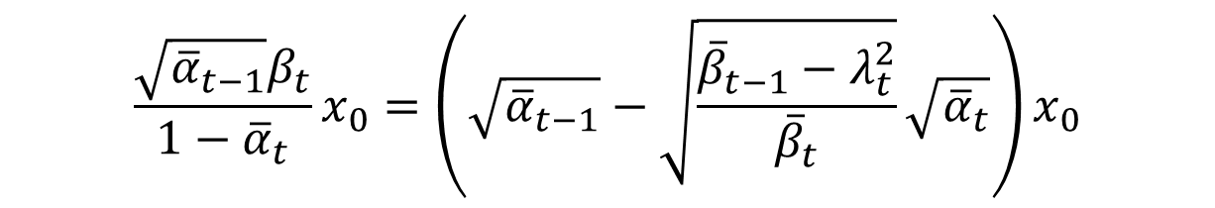

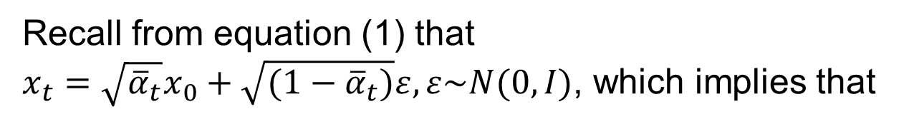
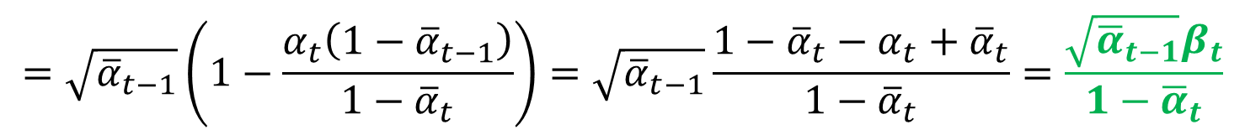
Next we show that
$$\frac{\sqrt{{\overline{α}}_{t−1}}β_{t}}{1−{\overline{α}}_{t}}x_{0}=\left(\sqrt{{\overline{α}}_{t−1}}−\sqrt{\frac{{\overline{β}}_{t−1}−λ_{t}^{2}}{{\overline{β}}_{t}}}\sqrt{{\overline{α}}_{t}}\right)x_{0}$$
$$\frac{\sqrt{α_{t}}\left(1−{\overline{α}}_{t−1}\right)}{1−{\overline{α}}_{t}}=\sqrt{\frac{{\overline{β}}_{t−1}−λ_{t}^{2}}{{\overline{β}}_{t}}.}$$
Using equation (5), we obtain
$\left(\sqrt{{\overline{α}}_{t−1}}−\sqrt{\frac{{\overline{β}}_{t−1}−λ_{t}^{2}}{{\overline{β}}_{t}}}\sqrt{{\overline{α}}_{t}}\right)$= $\sqrt{{\overline{α}}_{t−1}}−\frac{\sqrt{α_{t}}\left(1−{\overline{α}}_{t−1}\right)\sqrt{{\overline{α}}_{t}}}{1−{\overline{α}}_{t}}$
$$=\sqrt{{\overline{α}}_{t−1}}\left(1−\frac{α_{t}\left(1−{\overline{α}}_{t−1}\right)}{1−{\overline{α}}_{t}}\right)=\sqrt{{\overline{α}}_{t−1}}\frac{1−{\overline{α}}_{t}−α_{t}+{\overline{α}}_{t}}{1−{\overline{α}}_{t}}=\frac{\sqrt{{\overline{α}}_{t−1}}β_{t}}{1−{\overline{α}}_{t}}$$
(6)
Recall from equation (1) that
$x_{t}=\sqrt{{\overline{α}}_{t}}x_{0}+\sqrt{(1−{\overline{α}}_{t})}ε, ε\sim N(0,I)$, which implies that
(7)
$$x_{0}=\frac{x_{t}−\sqrt{1−{\overline{α}}_{t}}ε}{\sqrt{{\overline{α}}_{t}}}$$

Slide 15
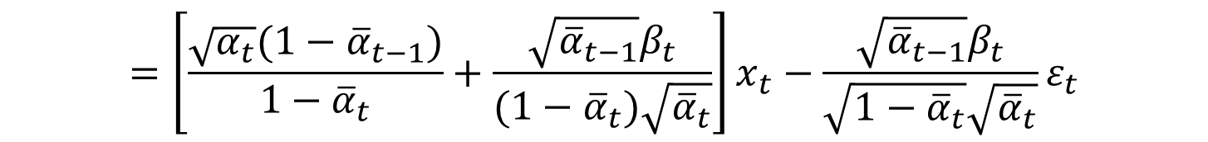

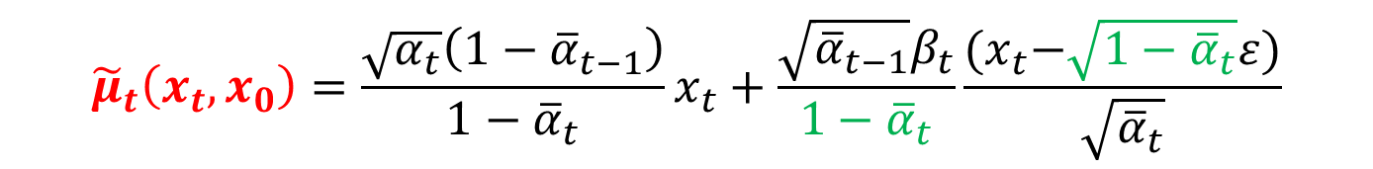


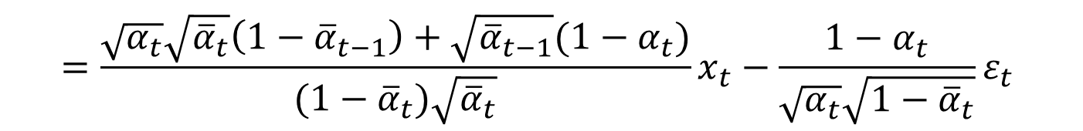
Substituting equation (7) into equation (4), we obtain
$$x_{0}=\frac{x_{t}−\sqrt{1−{\overline{α}}_{t}}ε}{\sqrt{{\overline{α}}_{t}}}$$
$${\tilde{μ}}_{t}\left(x_{t}, x_{0}\right)=\frac{\sqrt{α_{t}}\left(1−{\overline{α}}_{t−1}\right)}{1−{\overline{α}}_{t}}x_{t}+\frac{\sqrt{{\overline{α}}_{t−1}}β_{t}}{1−{\overline{α}}_{t}}\frac{{(x}_{t}−\sqrt{1−{\overline{α}}_{t}}ε)}{\sqrt{{\overline{α}}_{t}}}$$
$$=\left[\frac{\sqrt{α_{t}}(1−{\overline{α}}_{t−1})}{1−{\overline{α}}_{t}}+\frac{\sqrt{{\overline{α}}_{t−1}}β_{t}}{(1−{\overline{α}}_{t})\sqrt{{\overline{α}}_{t}}}\right]x_{t}−\frac{\sqrt{{\overline{α}}_{t−1}}β_{t}}{\sqrt{1−{\overline{α}}_{t}}\sqrt{{\overline{α}}_{t}}}ε_{t}$$
$$=\frac{\sqrt{α_{t}}\sqrt{{\overline{α}}_{t}}\left(1−{\overline{α}}_{t−1}\right)+\sqrt{{\overline{α}}_{t−1}}(1−α_{t})}{(1−{\overline{α}}_{t})\sqrt{{\overline{α}}_{t}}}x_{t}−\frac{1−α_{t}}{\sqrt{α_{t}}\sqrt{1−{\overline{α}}_{t}}}ε_{t}$$
$$=\frac{\sqrt{{\overline{α}}_{t−1}}(1−{\overline{α}}_{t})}{(1−{\overline{α}}_{t})\sqrt{{\overline{α}}_{t}}}x_{t}−\frac{1−α_{t}}{\sqrt{α_{t}}\sqrt{1−{\overline{α}}_{t}}}ε_{t}$$
$$=\frac{1}{\sqrt{α_{t}}}x_{t}−\frac{1−α_{t}}{\sqrt{α_{t}}\sqrt{1−{\overline{α}}_{t}}}ε_{t}=\frac{1}{\sqrt{α_{t}}}(x_{t}−\frac{1−α_{t}}{\sqrt{1−{\overline{α}}_{t}}}ε_{t})$$
(8)

Slide 16
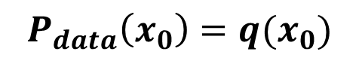
1.5.4. Negative Log-likelihood of the Diffusion Model
Negative Log-likelihood
$$𝓛=E_{x_{0}\sim P_{data(x_{0})}}[−\log{P_{θ}(x_{0})]}$$
$$P_{data}\left(x_{0}\right)=q(x_{0})$$
which isn’t quite computable in practice due to its dependance on (T) more random variables.
Lower Bound
$$𝓛≤E_{x_{0}\sim P_{data\left(x_{0}\right),x_{1:T}\sim q\left(x_{1:T} | x_{0}\right)}}[−\log{P_{θ}\left(x_{T}\right)−\sum_{t=1}^{T}{\log{\frac{P_{θ}(x_{t−1}|x_{t})}{q(x_{t}|x_{t−1})}]}}}$$
(A1)
Day, 2021, An introduction to Diffusion Probabilistic Models

Slide 17
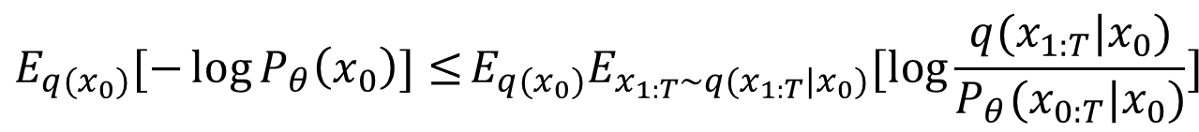
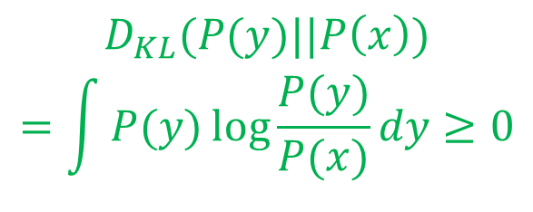

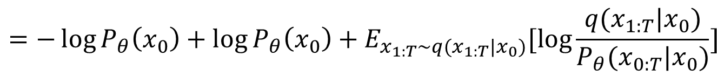
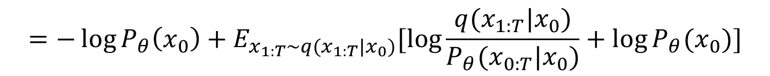
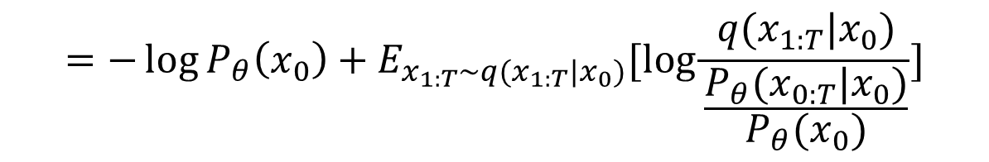

1.5.4. 1. One Approach to Derivation of ELOD
$$−\log{P_{θ}\left(x_{0}\right)≤−\log{P_{θ}\left(x_{0}\right)+D_{KL}\left[q\left(x_{1:T|x_{0}}\right)||P_{θ}(x_{1:T}|x_{0})\right]}}$$
$$D_{KL}(P(y)||P\left(x\right))$$
$$=\int{P(y)\log{\frac{P(y)}{P(x)}dy}}≥0$$
$$=−\log{P_{θ}\left(x_{0}\right)+E_{x_{1:T}\sim q(x_{1:T}|x_{0})}[\log{\frac{q(x_{1:T}|x_{0})}{\frac{P_{θ}(x_{0:T}|x_{0})}{P_{θ}(x_{0})}}]}}$$
$$=−\log{P_{θ}\left(x_{0}\right)+E_{x_{1:T}\sim q(x_{1:T}|x_{0})}[\log{\frac{q(x_{1:T}|x_{0})}{P_{θ}(x_{0:T}|x_{0})}+\log{P_{θ}(x_{0})]}}}$$
$$=−\log{P_{θ}\left(x_{0}\right)+\log{P_{θ}\left(x_{0}\right)}+E_{x_{1:T}\sim q(x_{1:T}|x_{0})}[\log{\frac{q(x_{1:T}|x_{0})}{P_{θ}(x_{0:T}|x_{0})}]}}$$
$$=E_{x_{1:T}\sim q(x_{1:T}|x_{0})}[\log{\frac{q(x_{1:T}|x_{0})}{P_{θ}(x_{0:T}|x_{0})}]}$$
$$E_{q(x_{0})}[−\log{P_{θ}\left(x_{0}\right)]≤}E_{q(x_{0})}E_{x_{1:T}\sim q(x_{1:T}|x_{0})}[\log{\frac{q(x_{1:T}|x_{0})}{P_{θ}(x_{0:T}|x_{0})}]}$$
$$𝓛_{0}=E_{q(x_{0:T}})[\log{\frac{q(x_{1:T}|x_{0})}{P_{θ}(x_{0:T}|x_{0})}]}$$
$$𝓛_{0}:Uppedr Bound$$
Weng 2021, What are Diffusion Models?

Slide 18
1.5.4. 2. Jansen’s inequality to Derivation of ELOD
Sohl-Dickstein et al., 2015 (section 2.3)

Slide 19

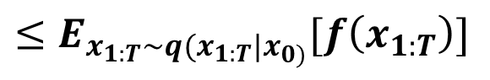

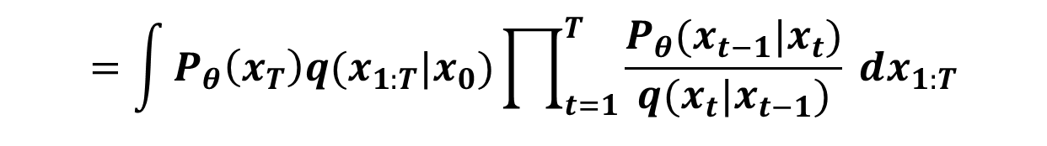
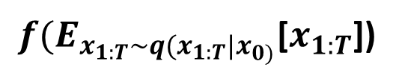
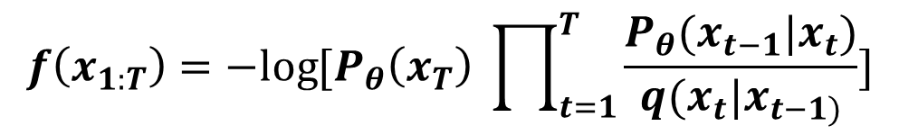
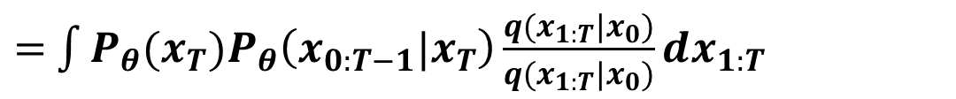
$$P_{θ}\left(x_{0}\right)=\int{P_{θ}\left(x_{0:T}\right)dx_{1:T}}$$
$$f\left(x_{1:T}\right)=−log{{[P}_{θ}\left(x_{T}\right) \prod_{t=1}^{T}{\frac{P_{θ}(x_{t−1}|x_{t})}{q(x_{t}|x_{t−1)}}]}}$$
$$=\int{P_{θ}\left(x_{0:T}\right)\frac{q(x_{1:T}|x_{0})}{q(x_{1:T}|x_{0})}dx_{1:T}}$$
$f(E_{x_{1:T}\sim q(x_{1:T}|x_{0)}}$[$x_{1:T}$])
$=$ $\int{{P_{θ}(x_{T})P}_{θ}\left(x_{0:T−1}|x_{T}\right)\frac{q(x_{1:T}|x_{0})}{q(x_{1:T}|x_{0})}dx_{1:T}}$
$$≤E_{x_{1:T}\sim q(x_{1:T}|x_{0)}}[f\left(x_{1:T}\right)]$$
$=$ $\int{P_{θ}\left(x_{T}\right)q(x_{1:T}|x_{0})\frac{P_{θ}(x_{0:T−1}|x_{T})}{q(x_{1:T}|x_{0})}dx_{1:T}}$
$$=\int{P_{θ}\left(x_{T}\right)q(x_{1:T}|x_{0})\prod_{t=1}^{T}{\frac{P_{θ}(x_{t−1}|x_{t})}{q(x_{t}|x_{t−1})}} dx_{1:T}}$$
Note that $−\log{P_{θ}\left(x_{0}\right)}$ is a convex function. Using Jansen’s inequality, we obtain
$$−\log{P_{θ}(x_{0})≤E_{x_{1:T}\sim q(x_{1:T}|x_{0)}}\left[[−\log{P_{θ}\left(x_{T}\right)−\sum_{t=1}^{T}{\log{\frac{P_{θ}(x_{t−1}|x_{t})}{q(x_{t}|x_{t−1})}}}}\right]}$$
$$𝓛≤E_{x_{0}\sim P_{data\left(x_{0}\right),x_{1:T}\sim q\left(x_{1:T} | x_{0}\right)}}[−\log{P_{θ}\left(x_{T}\right)−\sum_{t=1}^{T}{\log{\frac{P_{θ}\left(x_{t−1} | x_{t}\right)}{q\left(x_{t} | x_{t−1}\right)}}}}]$$
Thus,

Slide 20

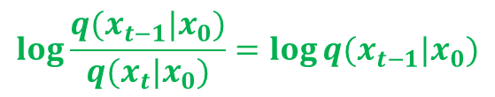
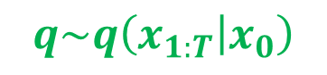
Define
$${𝓛_{0}=E}_{x_{0}\sim P_{data\left(x_{0}\right),x_{1:T}\sim q\left(x_{1:T} | x_{0}\right)}}[−\log{P_{θ}\left(x_{T}\right)−\sum_{t=1}^{T}{\log{\frac{P_{θ}\left(x_{t−1} | x_{t}\right)}{q\left(x_{t} | x_{t−1}\right)}]}}}$$
We can show
$$q\sim q\left(x_{1:T} | x_{0}\right)$$
$$𝓛_{0}=E_{q}\left[D_{KL}(q(x_{T}|x_{0})|\left|P_{θ}\left(x_{T}\right)\right)+\sum_{t>1}{D_{KL}(q(x_{t−1}|x_{t},x_{0})||P_{θ}\left(x_{t−1} | \left|x_{t}\right)\right)−\log{P_{θ}(x_{0}|x_{1})}}\right]$$
Using Markov property, we have $q\left(x_{t} | x_{t−1}\right)=q\left(x_{t−1} | x_{t},x_{0}\right)\frac{q\left(x_{t} | x_{0}\right)}{q\left(x_{t−1} | x_{0}\right)},$using equation (A1)
$$𝓛_{0}=E_{q}[−\log{P_{θ}\left(x_{T}\right)−\sum_{t=2}^{T}{\log{\frac{P_{θ}\left(x_{t−1} | x_{t}\right)}{q\left(x_{t} | x_{t−1}\right)}−\log{\frac{P_{θ}(x_{0}|x_{1})}{q(x_{1}|x_{0})}}]}}}$$
$$=E_{q}[−\log{P_{θ}\left(x_{T}\right)−\sum_{t=2}^{T}{\log{\frac{P_{θ}\left(x_{t−1} | x_{t}\right)}{q\left(x_{t−1} | x_{t}, x_{0}\right)}\frac{q(x_{t−1}|x_{0})}{q(x_{t}|x_{0})}−\log{\frac{P_{θ}(x_{0}|x_{1})}{q(x_{1}|x_{0})}}]}}}$$
$$=E_{q}\left[−\log{\frac{P_{θ}\left(x_{T}\right)}{q\left(x_{T} | x_{0}\right)}}−\sum_{t>1}{\log{\frac{P_{θ}\left(x_{t−1} | x_{t}\right)}{q\left(x_{t−1} | x_{t}, x_{0}\right)}}}−\log{P_{θ}(x_{0}|x_{1})}\right]$$
$$\log{\frac{q(x_{t−1}|x_{0})}{q(x_{t}|x_{0})}=\log{q(x_{t−1}|x_{0})}}$$
$$−\log{q(x_{t}|x_{0})}$$
$$=D_{KL}(q(x_{T}|x_{0})|\left|P_{θ}\left(x_{T}\right)\right)+\sum_{t>1}{D_{KL}(q\left(x_{t−1} | x_{t}, x_{0}\right)||P_{θ}\left(x_{t−1} | x_{t}\right))−\log{P_{θ}(x_{0}|x_{1})}}$$

Slide 21
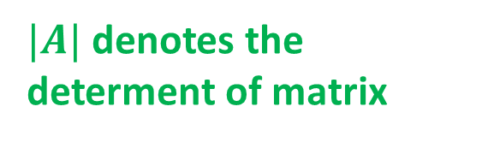
1.5.5. Closed Form for Negative Log-likelihood
Reverse Process: $q\left(x_{t−1} | x_{t}, x_{0}\right)=N(x_{t−1};{\tilde{μ}}_{t }\left(x_{t},x_{0}\right),{\tilde{Σ}}_{t}\left(x_{t}, x_{0}\right))$
$${\tilde{Σ}}_{t}\left(x_{t}, x_{0}\right)={\tilde{β}}_{t}I$$
$$q\left(x_{t−1} | x_{t}, x_{0}\right)={\left(2π\right)}^{−\frac{d}{2}}{\left|{\tilde{Σ}}_{t}\left(x_{t}, x_{0}\right)\right|}^{−\frac{1}{2}}exp\left\{−\frac{1}{2}{\left(x_{t−1}−{\tilde{μ}}_{t }\left(x_{t},x_{0}\right)\right)}^{T}{\left({\tilde{β}}_{t}I\right)}^{−1}\left(x_{t−1}−{\tilde{μ}}_{t }\left(x_{t},x_{0}\right)\right)\right\}$$
(A2)
$|A|$ denotes the determent of matrix
$P_{θ}\left(x_{t−1} | x_{t}\right)=N(x_{t−1}; μ_{θ}\left(x_{t},t\right), Σ_{θ}\left(x_{t},t\right))$
$$P_{θ}\left(x_{t−1} | x_{t}\right)={\left(2π\right)}^{−\frac{d}{2}}{\left|Σ_{θ}\left(x_{t},t\right)\right|}^{−\frac{d}{2}}exp\left\{−\frac{1}{2}{\left(x_{t−1}−μ_{θ}\left(x_{t},t\right)\right)}^{T}Σ_{θ}^{−1}(x_{t},t)\left(x_{t−1}−μ_{θ}\left(x_{t},t\right)\right)\right\}$$
(A3)
$q\left(x_{T} | x_{0}\right)=N(x_{T}; \sqrt{{\overline{α}}_{T}}x_{0}, \left(1−{\overline{α}}_{T}\right)I)$
(A4)
Negative log-likelihood $𝓛_{0}$ has three terms. (1) $D_{KL}(q(x_{T}|x_{0})|\left|P_{θ}\left(x_{T}\right)\right)$, (2)
${L_{t}=D}_{KL}(q\left(x_{t−1} | x_{t}, x_{0}\right)|\left|P_{θ}\left(x_{t−1} | x_{t}\right)\right)$ and (3) $\log{P_{θ}(x_{0}|x_{1})}$.
Since (A4) only involves the pre-specified ${\overline{α}}_{T}$ and $P_{θ}\left(x_{T}\right)$= N(0,I), the first term does not have parameters to be estimated. Thus, the first term is ignored.

Slide 22
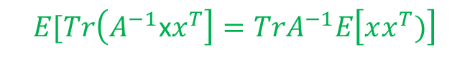
1.5.5.1. Computing
$${L_{t}=D}_{KL}(q\left(x_{t−1} | x_{t}, x_{0}\right)|\left|P_{θ}\left(x_{t−1} | x_{t}\right)\right)$$
Computing
Using equations (A2) and (A3), we obtain
$$q\sim q\left(x_{t−1} | {x_{t},x}_{0}\right)$$
$${L_{t}=E}_{q}\left\{log\frac{q(x_{t−1}|x_{t},x_{0})}{P_{θ}(x_{t−1}|x_{t})}\right\}={\frac{1}{2}E}_{q}\left\{\log\left|Σ_{θ}(x_{t}, t)\right|−\log\left|{\tilde{Σ}}_{t}(x_{t}, x_{0})\right|\right\}{ }$$
$$−\frac{1}{2}E_{q}\left\{{\left[x_{t−1}−{\tilde{μ}}_{t}(x_{t},x_{0})\right]}^{T}{\left[{\tilde{Σ}}_{t}(x_{t}, x_{0})\right]}^{−1}\left[x_{t−1}−{\tilde{μ}}_{t}(x_{t},x_{0})\right]\right\}$$
$$+\frac{1}{2}E_{q}\left\{{\left[x_{t−1}−μ_{θ}(x_{t},t)\right]}^{T}{\left[Σ_{θ}(x_{t},t)\right]}^{−1}\left[x_{t−1}−μ_{θ}(x_{t},t)\right]\right\}$$
$$E[Tr\left(A^{−1}\text{x}x^{T}\right]={TrA}^{−1}E\left[xx^{T})\right]$$
$$(E\left[x^{T}A^{−1}x\right]=E[Tr\left(x^{T}A^{−1}x\right]=$$
$$={Tr(A}^{−1}A)=Tr\left(I\right)=d)$$
$$=\frac{1}{2}\log\left|Σ_{θ}(x_{t}, t)\right|−\log\left|{\tilde{Σ}}_{t}\left(x_{t}, x_{0}\right)\right|−\frac{d}{2}+\frac{1}{2}E_{q}\left\{{\left[x_{t−1}−μ_{θ}(x_{t},t)\right]}^{T}{\left[Σ_{θ}(x_{t},t)\right]}^{−1}\left[x_{t−1}−μ_{θ}(x_{t},t)\right]\right\}$$

Slide 23
$$=\frac{1}{2}\log\left|Σ_{θ}(x_{t}, t)\right|−\log\left|{\tilde{Σ}}_{t}\left(x_{t}, x_{0}\right)\right|−\frac{d}{2}+\frac{1}{2 }E_{q}\left\{Tr\left\{{\left[x_{t−1}−μ_{θ}(x_{t},t)\right]}^{T}{\left[Σ_{θ}(x_{t},t)\right]}^{−1}\left[x_{t−1}−μ_{θ}(x_{t},t)\right]\right\}\right\}$$
$$=\frac{1}{2}\log\left|Σ_{θ}(x_{t}, t)\right|−\log\left|{\tilde{Σ}}_{t}\left(x_{t}, x_{0}\right)\right|−\frac{d}{2}+\frac{1}{2}Tr\left\{{\left[Σ_{θ}(x_{t},t)\right]}^{−1}E_{q}\left[x_{t−1}−μ_{θ}(x_{t},t)\right]{\left[x_{t−1}−μ_{θ}(x_{t},t)\right]}^{T}\right\}$$
(A5)
However, $E_{q}\left\{\left[x_{t−1}−μ_{θ}(x_{t},t)\right]{\left[x_{t−1}−μ_{θ}(x_{t},t)\right]}^{T}\right\}$
$${=E}_{q}\left\{\left[x_{t−1}−{\tilde{μ}}_{t}\left(x_{t},x_{0}\right)+{\tilde{μ}}_{t}\left(x_{t},x_{0}\right)−μ_{θ}(x_{t},t)\right]{\left[x_{t−1}−{\tilde{μ}}_{t}\left(x_{t},x_{0}\right)+{\tilde{μ}}_{t}\left(x_{t},x_{0}\right)−μ_{θ}(x_{t},t)\right]}^{T}\right\}$$
(A6)

Slide 24

$$=\frac{1}{2}\log\left|Σ_{θ}(x_{t}, t)\right|−\log\left|{\tilde{Σ}}_{t}\left(x_{t}, x_{0}\right)\right|−\frac{d}{2}+$$
$$\frac{1}{2}Tr\left[Σ_{θ}^{−1}\left(x_{t},t\right){\tilde{Σ}}_{θ}\left(x_{t}, x_{0}\right)+\frac{1}{2}{\left[{\tilde{μ}}_{t}\left(x_{t},x_{0}\right)−μ_{θ}(x_{t},t)\right]}^{T}Σ_{θ}^{−1}\left(x_{t},t\right)\left[{\tilde{μ}}_{t}\left(x_{t},x_{0}\right)−μ_{θ}(x_{t},t)\right]\right]$$
(A7)

Slide 25
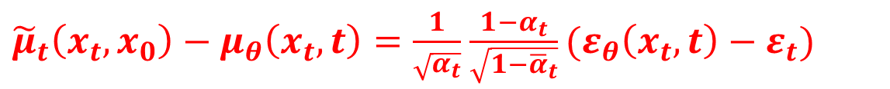
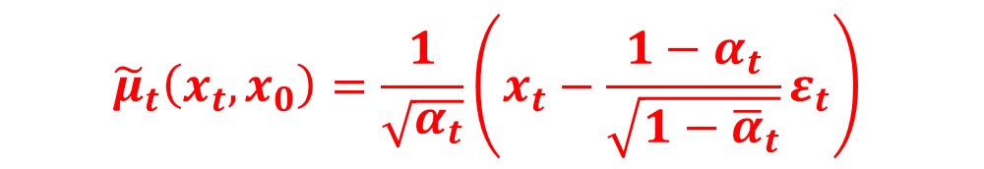
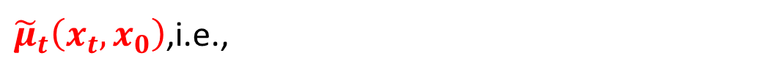
Recall equation (8):
$${\tilde{μ}}_{t}\left(x_{t}, x_{0}\right)=\frac{1}{\sqrt{α_{t}}}\left(x_{t}−\frac{1−α_{t}}{\sqrt{1−{\overline{α}}_{t}}}ε_{t}\right)$$
To make $L_{t}$small, we assume that $μ_{θ}(x_{t},t)$ takes the same mathematical form as
${\tilde{μ}}_{t}\left(x_{t}, x_{0}\right)$,i.e.,
$μ_{θ}\left(x_{t},t\right)=\frac{1}{\sqrt{α_{t}}}\left(x_{t}−\frac{1−α_{t}}{\sqrt{1−{\overline{α}}_{t}}}ε_{θ}(x_{t},t)\right)$, where $ε_{θ}(x_{t},t)$ is implemented by a neural network.
Therefore,
${\tilde{μ}}_{t}\left(x_{t},x_{0}\right)−μ_{θ}\left(x_{t},t\right)=\frac{1}{\sqrt{α_{t}}}$ $\frac{1−α_{t}}{\sqrt{1−{\overline{α}}_{t}}}(ε_{θ}\left(x_{t},t\right)−ε_{t})$
$$L_{t}=\frac{1}{2}\frac{{\left(1−α_{t}\right)}^{2}}{α_{t}\left(1−{\overline{α}}_{t}\right)}E_{(x_{0},ε_{t})}\left[{ (ε_{θ}\left(x_{t},t\right)−ε_{t})}^{T}Σ_{θ}^{−1}\left(x_{t},t\right) (ε_{θ}\left(x_{t},t\right)−ε_{t})\right]$$

Slide 26
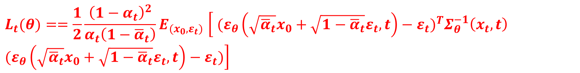

1.5.5.2 Optimize Loss Function
Loss Function
$$L_{t}(θ){==\frac{1}{2}\frac{{\left(1−α_{t}\right)}^{2}}{α_{t}\left(1−{\overline{α}}_{t}\right)}E}_{(x_{0},ε_{t})}\left[{ (ε_{θ}\left(\sqrt{{\overline{α}}_{t}}x_{0}+\sqrt{1−{\overline{α}}_{t}}ε_{t},t\right)−ε_{t})}^{T}Σ_{θ}^{−1}\left(x_{t},t\right) (ε_{θ}\left(\sqrt{{\overline{α}}_{t}}x_{0}+\sqrt{1−{\overline{α}}_{t}}ε_{t},t\right)−ε_{t})\right]$$
Simplification
$$L_{t}^{simple}(θ)=E_{t\sim \left[1,T\right], x_{0, ε_{t}}}\left[{\left\|(ε_{θ}\left(\sqrt{{\overline{α}}_{t}}x_{0}+\sqrt{1−{\overline{α}}_{t}}ε_{t},t\right)−ε_{t}\right\|}^{2}\right]$$
$$\min_{θ}{L_{t}(θ)}$$

Slide 27
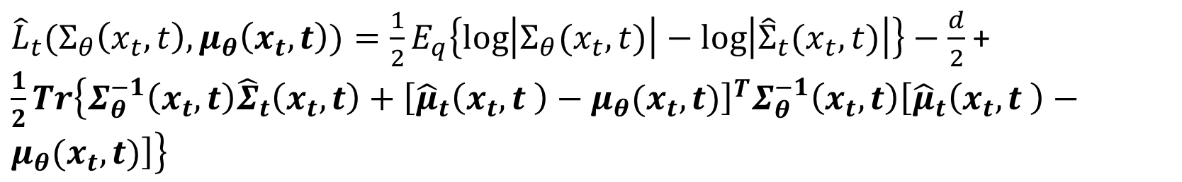
1.5.5.3. Optimal General Loss Function
$${{Let \hat{L}}_{t}=D}_{KL}(q\left(x_{t−1} | x_{t}\right)|\left|P_{θ}\left(x_{t−1} | x_{t}\right)\right)$$
${\hat{L}}_{t}(Σ_{θ}\left(x_{t}, t\right),μ_{θ}\left(x_{t},t\right))={\frac{1}{2}E}_{q}\left\{\log\left|Σ_{θ}(x_{t}, t)\right|−\log\left|{\hat{Σ}}_{t}(x_{t},t)\right|\right\}−\frac{d}{2}$ + $\frac{1}{2}Tr\left\{Σ_{θ}^{−1}\left(x_{t},t\right){\hat{Σ}}_{t}\left(x_{t}, t\right)+{\left[{\hat{μ}}_{t}\left(x_{t},t \right)−μ_{θ}(x_{t},t)\right]}^{T}Σ_{θ}^{−1}\left(x_{t},t\right)\left[{\hat{μ}}_{t}\left(x_{t},t \right)−μ_{θ}(x_{t},t)\right]\right\}$
$${\hat{μ}}_{t}\left(x_{t},t \right)=E_{q(x_{t−1}|x_{t})}\left[x_{t−1}\right]=E_{q(x_{0}|x_{t})}E_{q\left(x_{t−1} | x_{t},x_{0}\right)}[x_{t−1}]$$
where
$$=E_{q(x_{0}|x_{t})}\left[{\tilde{μ}}_{t}\left(x_{t},x_{0}\right)\right]={\tilde{μ}}_{t}\left(x_{t},{E_{q(x_{0}|x_{t})}x}_{0}\right)$$
$$S=\left[{\hat{μ}}_{t}\left(x_{t},t \right)−μ_{θ}(x_{t},t)\right]{\left[{\hat{μ}}_{t}\left(x_{t},t \right)−μ_{θ}(x_{t},t)\right]}^{T}$$
$${\hat{Σ}}_{t}\left(x_{t}, t\right)={Cov}_{q\left(x_{t−1} | x_{t}\right)}\left(x_{t−1}\right)=E_{q\left(x_{0} | x_{t}\right)}{Cov}_{q\left(x_{t−1} | x_{t},x_{0}\right)}(x_{t−1})$$
$$+{Cov}_{q(x_{0}|x_{t})}E_{q(x_{t−1}|x_{t},x_{0})}\left[x_{t−1}\right]={\tilde{Σ}}_{θ}\left(x_{t}, {E_{q\left(x_{0} | x_{t}\right)}[x}_{0}]\right)+{Cov}_{q\left(x_{0} | x_{t}\right)}(\tilde{μ}\left(x_{t},x_{0}\right))$$

Slide 28
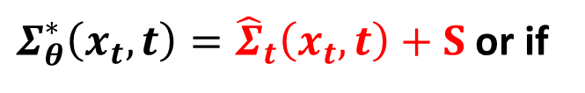
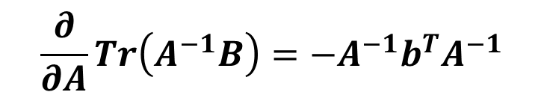




1.5.5.3. Optimal General Loss Function
$$\min_{Σ_{θ}\left(x_{t}, t\right),μ_{θ}\left(x_{t},t\right)}{{\hat{L}}_{t}(Σ_{θ}\left(x_{t}, t\right),μ_{θ}\left(x_{t},t\right))}$$
Goal:
Similar to 1.5.5.1, we can obtain
${\hat{L}}_{t}(Σ_{θ}\left(x_{t}, t\right),μ_{θ}\left(x_{t},t\right))=\frac{1}{2}\log\left|Σ_{θ}(x_{t}, t)\right|−\log\left|{\hat{Σ}}_{t}(x_{t},t)\right|−\frac{d}{2}$ + $\frac{1}{2}Tr\left\{Σ_{θ}^{−1}\left(x_{t},t\right){\hat{Σ}}_{t}\left(x_{t}, t\right)+Σ_{θ}^{−1}\left(x_{t},t\right)\left[{\hat{μ}}_{t}\left(x_{t},t \right)−μ_{θ}(x_{t},t)\right]{\left[{\hat{μ}}_{t}\left(x_{t},t \right)−μ_{θ}(x_{t},t)\right]}^{T}\right\}$
$$Let S=\left[{\hat{μ}}_{t}\left(x_{t},t \right)−μ_{θ}(x_{t},t)\right]{\left[{\hat{μ}}_{t}\left(x_{t},t \right)−μ_{θ}(x_{t},t)\right]}^{T}$$
Matrix Calculus:
$$\frac{∂\log{|A|}}{∂A}=A^{−T}$$
$$\frac{∂}{∂A}Tr\left(A^{−1}B\right)=−A^{−1}b^{T}A^{−1}$$
$\frac{∂}{∂Σ_{θ}(x_{t}, t)}{\hat{L}}_{t}=\frac{1}{2}{Σ_{θ}(x_{t}, t)}^{−1}−\frac{1}{2}Σ_{θ}^{−1}\left(x_{t},t\right){\hat{Σ}}_{t}\left(x_{t}, t\right)$ $Σ_{θ}^{−1}\left(x_{t},t\right)−\frac{1}{2}Σ_{θ}^{−1}\left(x_{t},t\right)SΣ_{θ}^{−1}\left(x_{t},t\right)=0$
$Σ_{θ}^{∗}\left(x_{t}, t\right)={\hat{Σ}}_{t}\left(x_{t},t\right)+S$ or if
$$μ_{θ}^{∗}\left(x_{t},t\right)={\hat{μ}}_{t}\left(x_{t},t \right)= {\tilde{μ}}_{t}\left(x_{t},{E_{q(x_{0}|x_{t})}x}_{0}\right)$$
Solving it, we obtain
Then $Σ_{θ}^{∗}\left(x_{t}, t\right)={\hat{Σ}}_{t}\left(x_{t},t\right)$
Bao, et al. 2022; ANALYTIC-DPM: AN ANALYTIC ESTIMATE OF THE OPTIMAL REVERSE VARIANCE IN DIFFUSION PROBABILISTIC MODELS

Slide 29

Algorithm 1 Training
Step 1: Repeat
Step 2: $x_{0}\sim q\left(x_{0}\right)$
Step 3: $t\sim Uniform \left(\left[1,…,T\right]\right)$
Step 4: $ε\sim N(0,I)$
Stepn5: Gradient
$∇_{θ}$ ${\left\|(ε_{θ}\left(\sqrt{{\overline{α}}_{t}}x_{0}+\sqrt{1−{\overline{α}}_{t}}ε_{t},t\right)−ε_{t}\right\|}^{2}$
Step 6: Until Converged

Slide 30


Algorithm 2 Sampling
Step 1: $X_{T}\sim N\left(0,I\right)$
Step 2: for $t=T,…, 1 do$
Step 3: $z\sim N(0, I)$
Step 4: if $t>1 then$
$x_{t−1}=\frac{1}{\sqrt{α_{t}}}\left(x_{t}−\frac{1−α_{t}}{\sqrt{1−{\overline{α}}_{t}}}ε_{θ}(x_{t},t)\right)+σ_{t}z$ Step 5: end for
Step 6: Return $x_{0}$
${\tilde{μ}}_{t}\left(x_{t}, x_{0}\right)$ $=\frac{1}{\sqrt{α_{t}}}\left(x_{t}−\frac{1−α_{t}}{\sqrt{1−{\overline{α}}_{t}}}ε_{t}\right)$

Slide 31

Max Welling et al. 2022; Equivariant Diffusion for Molecule Generation in 3D
Michael Galkin, 2022. Denoising Diffusion Generative Models in Graph ML

Slide 32

Michael Galkin, 2022. Denoising Diffusion Generative Models in Graph ML

